Slide 1
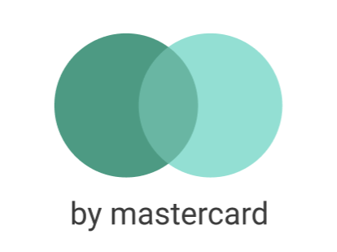
GreenWallet
Your green initiative

Slide 2
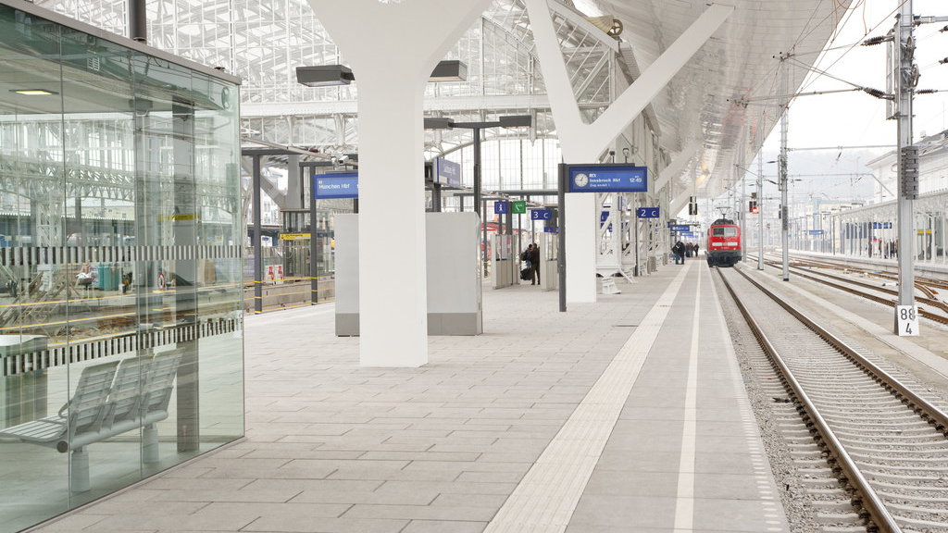

Slide 3
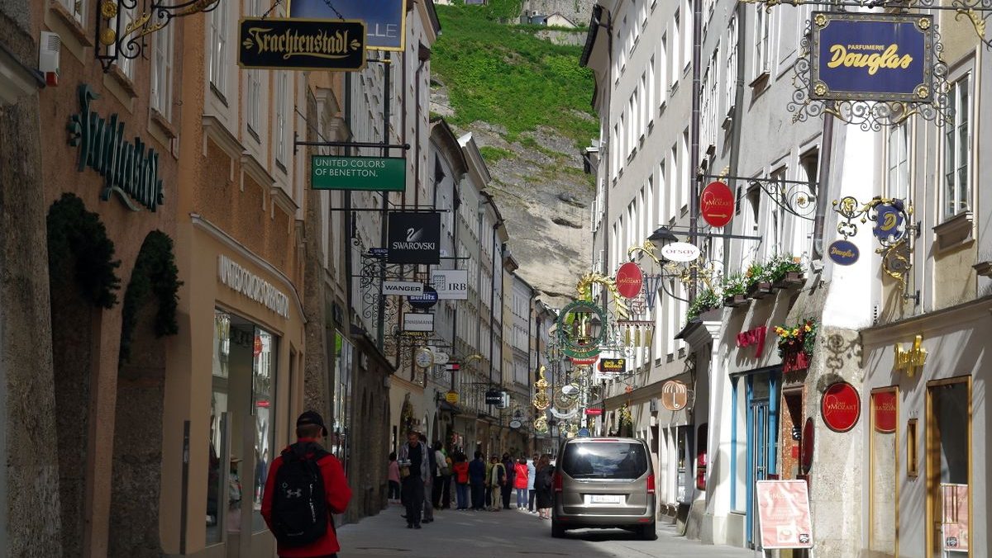
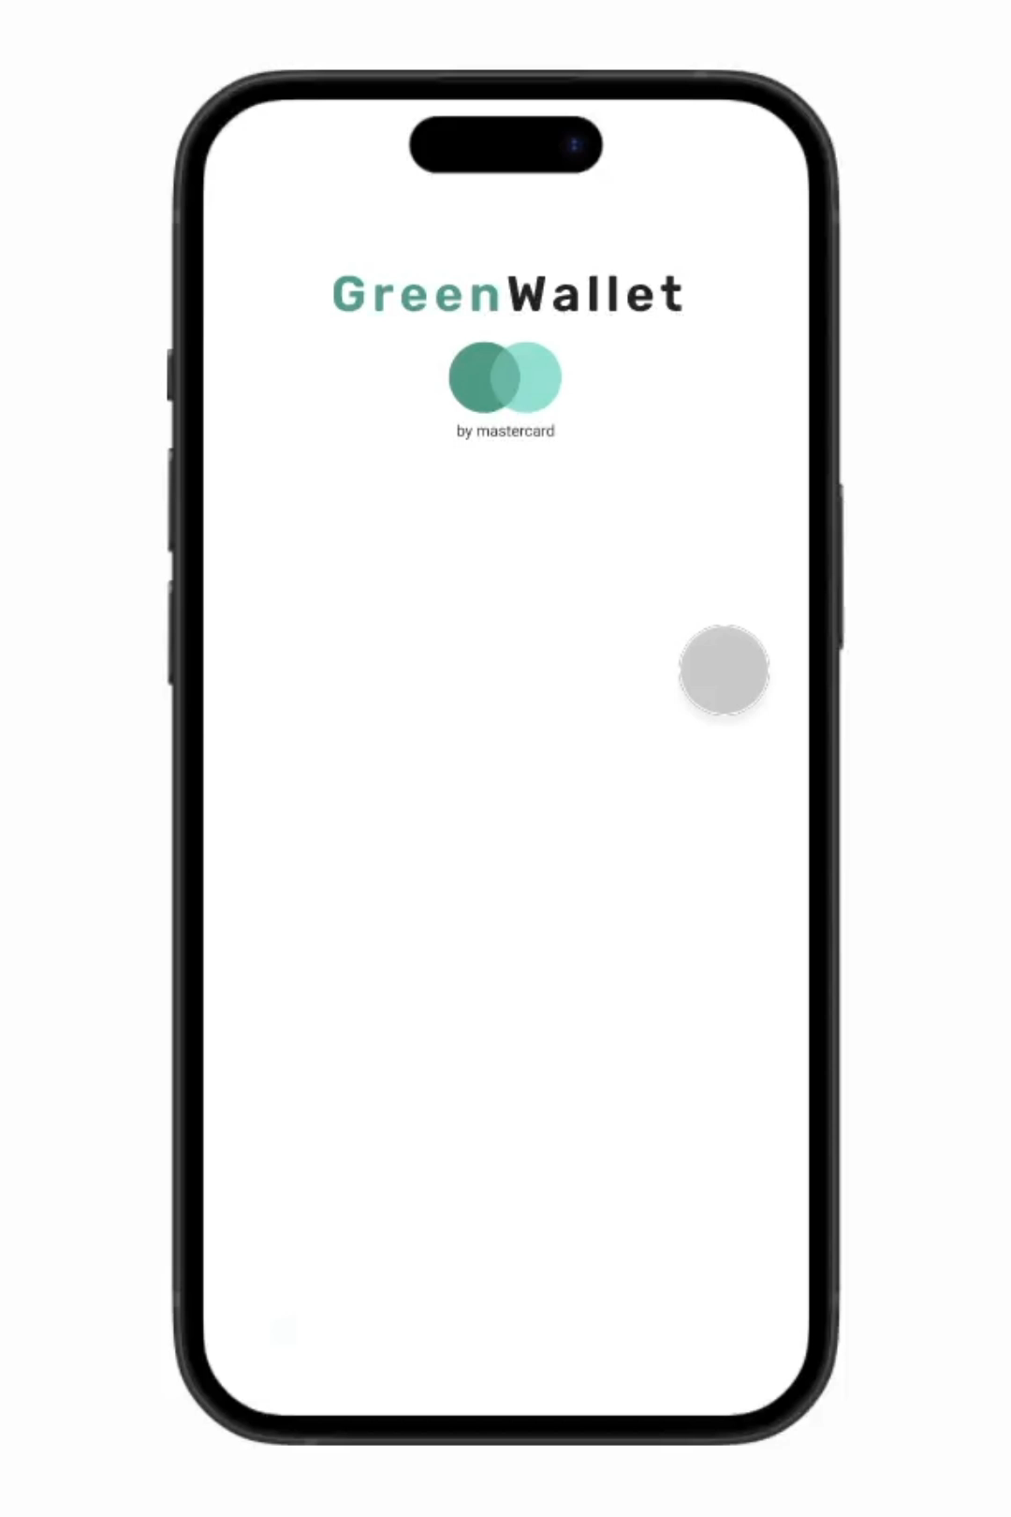

Slide 4




Benefits
Mastercard
Users
Owners
Tourism regions
Plant trees
Discover new places
More equal distribution of people
Improved Image
Attract more customers
Notes:
≈20s

Slide 6
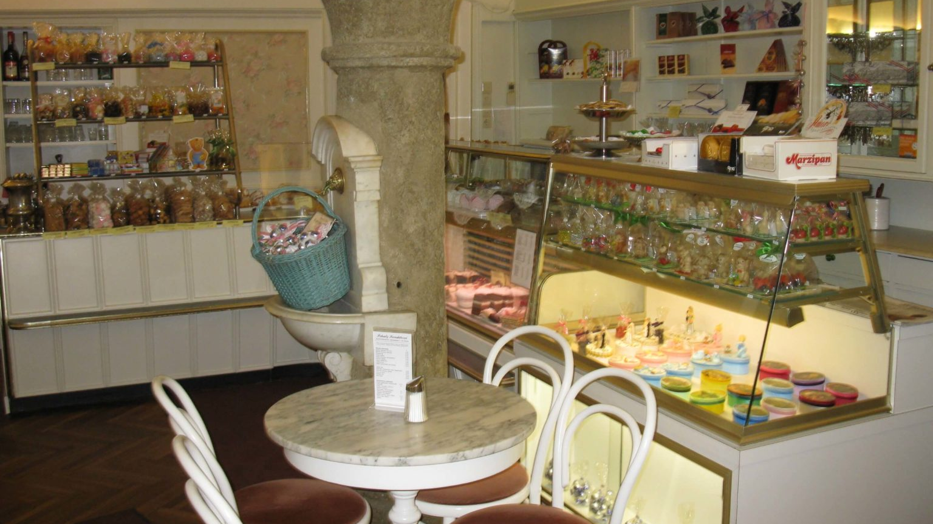

Slide 7
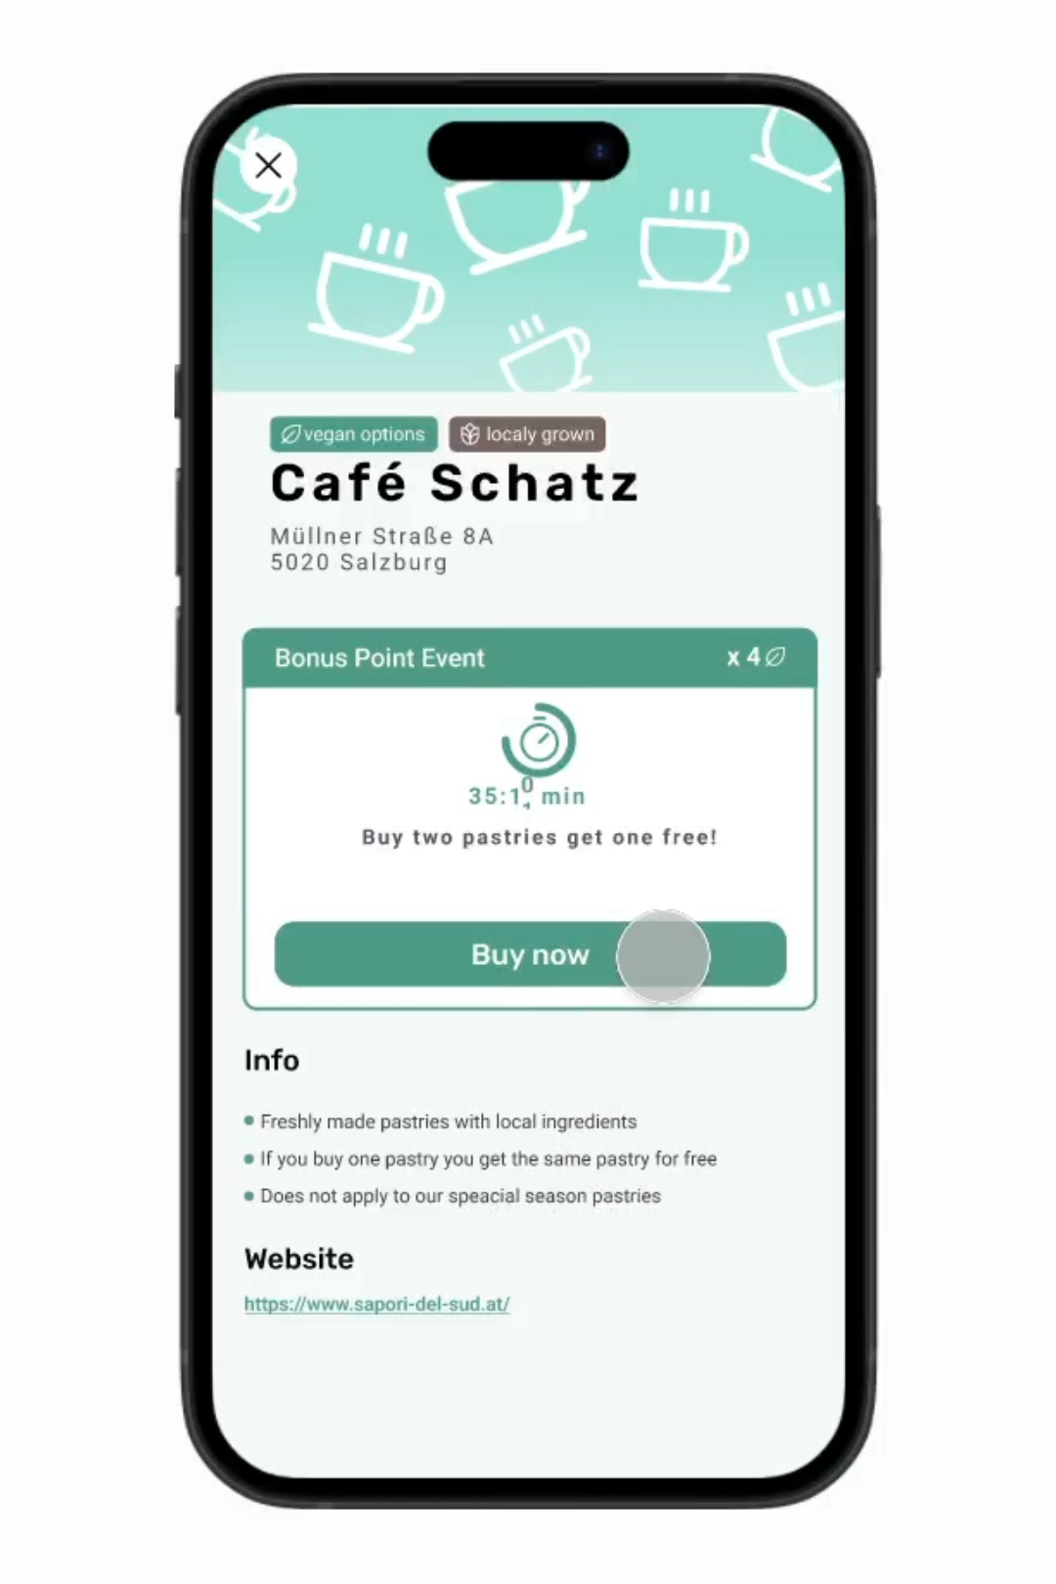

Slide 8
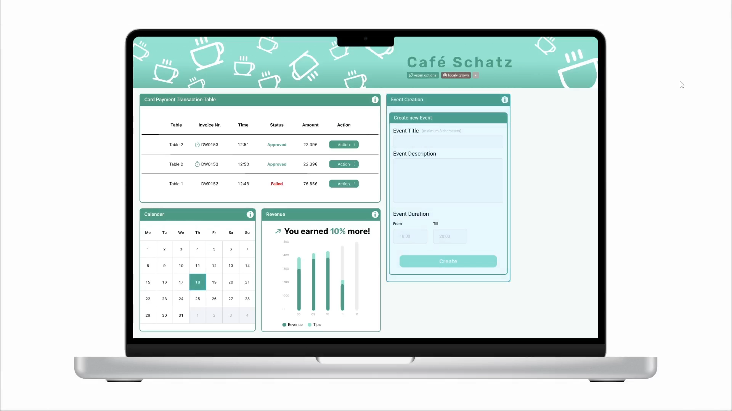

Slide 9
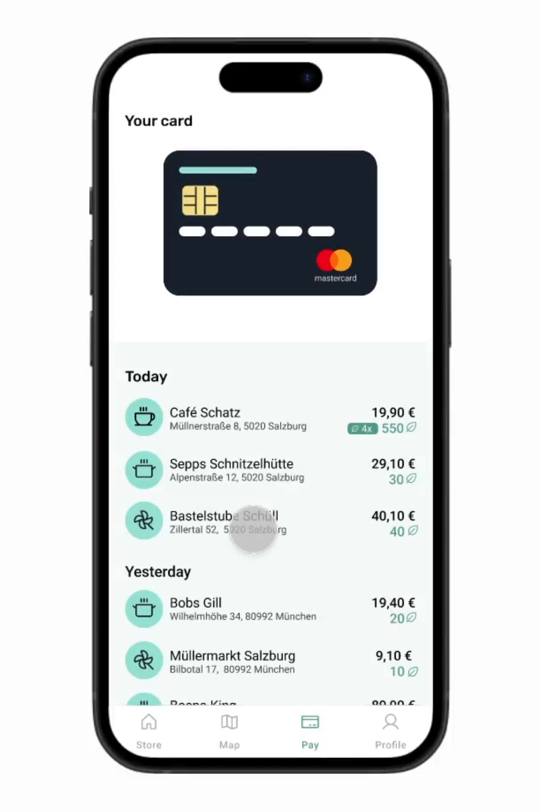

Slide 10
GreenWallet
Thank you

